Slide 1


Digital Freelancer:
Managing Freelancing Projects
Project: Working with a Mock Client

Slide 2
Part 1
Project Listing

Slide 3
Sample Project Listing #3: Data Analyst
Seeking experienced Data Analyst to build dashboard for local insurance company.
Posted 1 week ago
Hourly: $90.00 Based on experience.
Project Time: 1 year, 20 hours a week.
Project Description:
I have taken over a local car insurance company from my parents and have inherited hundreds of Excel spreadsheets with past and current customer information. I need help organizing this data and creating a dashboard to allow me to filter the data and create reports as needed. I would also need guidance on how to transfer the data to the tool of your choice. Looking forward to working together!

Slide 4
Part 2
Expression of Interest

Slide 5
Expression of Interest
Write an initial expression of interest (EoI) to the client:
Now that you’ve understood what the client is asking for, it’s time for you to reach out to them.
Write out an EoI message addressing their requirements as well as how you can help them.
This message will be their first impression of how you communicate with them, so it is good to be professional.
Please keep word limit between 200 - 300 words.

Slide 6
Expression of Interest (Provided)
Sample Project Listing #3: Data Analyst
Expression of Interest:
Dear
Thank you for considering my services. I am a very hard worker with +2 experience in doing Freelancing jobs. I believe I can help you with your request with aiming to maintain and develop your parents' legacy. First, I need to understand more about your requirements to figure out which charts and dashboard best to represent your data. By cleaning, organizing and filtering data It could be more helpful for you to consider building KPI dashboard which offers at-a-glance insights based on key performance indicators (KPIs). Such KPIs which will enable you to consistently track your performance and progress against your customer focused strategic objectives, drive up customer satisfaction and boost customer retention.
This Interactive Dashboard emanating from your Excel spreadsheets could be using Python programming language and Panda's library which is a software library written for the Python programming language for data manipulation and analysis, through working with Jupyter Notebook to develop the dashboard which is a web-based interactive computing platform.
Given my substantial experience in Data Analysis and working with different spreadsheet types, I’m confident I can help you in making helpful reports and guide you through the process of transferring data, also organizing and creating your required Dashboard, Data Visualizations and Infographics using Tableau within your specific time frame.
You will find my proposal for plan of activities for your project and pricing based on my estimation of your content needs. Looking forward to a fruitful collaboration.
Muhammad Bonn
WhatsApp: 201114884545

Slide 7
Part 3
Project Management Process

Slide 8
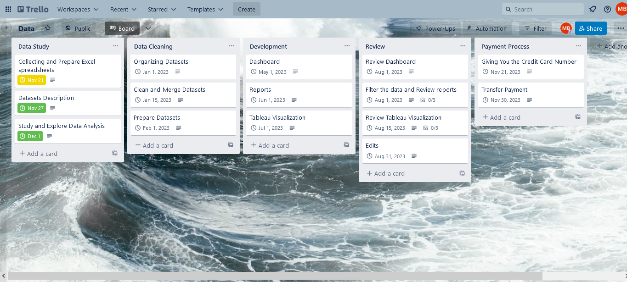
Trello Board
Please include the following information for your Trello board:
A link to your public Trello board should be provided here:
https://trello.com/b/qv3AwZEi/data
Include a screenshot of the board below:

Slide 9
Part 4
Invoice and Payment Options

Slide 10
Muhammad Elsayed Bonn
Fowah, Egypt
Invoice
Recipient:
[Company/Client Name]
[Client Address]
Invoice #: 20231121-001
Date issued: 21 Nov 2023
Date due: 30 Nov 2023
Services Rendered
Service | Description of Work Done | Hours Spent | Amount Per Hour | Total
Data Studying | Collecting and Prepare Excel spreadsheets and Datasets. Description and Study and Explore of Data Analysis. | 15 | $2 | $30
Data Cleaning | Organizing Datasets, Clean, Merge and Prepare Datasets. | 25 | $3 | $75
Development | Creating required Dashboard, Reports and Tableau Visualizations. | 50 | $4 | $200
Edits | Finalization and Required Edits | 20 | $2 | $40
Total Payment Due: $345
Payment: PayPal
A/C: 12AB-34CD
Bank: Ahli Bank

